Slide 1

NEM + & BYOD + control logic

Slide 2
1. Definition
NEM+ (Net Energy Metering Plus): Applicable to users who have participated in the early NEM, allowing them to add solar panels or batteries while retaining the original NEM contract.
BYOD (Bring Your Own Device): The original version is an optional incentive program where users install their own batteries to participate in grid support. Daily discharge is not mandatory and users only respond when the grid calls.
BYOD+ program: A new policy from 2025 onwards, aimed at more proactively integrating user batteries into daily grid peak management.

Slide 3
Comparison between NEM + & BYOD and NEM + & BYOD +
Comparison Dimensions | NEM+/BYOD | NEM+/BYOD+
Basic Mechanics | Keep the original NEM+ contract | same
Battery usage mode | User-defined, on-demand response | Discharge must be done at a specified time every day (two hours)
One-time subsidy | None or very little | $400/kW (up to $800/kW )
Contract Requirements | No long-term contract or loose contract | Mandatory for 5 years, early withdrawal requires refund of subsidies
Monthly income | Possibly (low), not fixed | based on exported electricity + retail price
Target Group | Free scheduling, flexible users | Users who are willing to participate in scheduling for a long time and obtain high subsidies

Slide 4
3. Current Design Scheduling Strategy
NEM PV is fed into the grid and cannot participate in battery charging, even when the FHP low SOC cannot meet the two-hour discharge;
2. NEM + PV is dispatched according to the following table strategy
Time Break | Peaks and valleys | Photovoltaic ( NEM + PV ) power priority | Load power priority | Logical description
00:00 - 07:00 | valley | load > FHP Charge > Grid Feed | Pv > FHP > Grid | Photovoltaic power supply is prioritized, the remaining power is used to charge aPower , and the remaining power is fed back to the grid. If the PV load is insufficient, it will be supported by aPower , and if it is still insufficient, it will be supported by the mains.
07:00 - 15:00 | flat | load > FHP Charge > Grid Feed | Pv > FHP > Grid | Photovoltaic power supply is prioritized, the remaining power is used to charge aPower , and the remaining power is fed back to the grid. If the PV load is insufficient, it will be supported by aPower , and if it is still insufficient, it will be supported by the mains. Reserve SOC80%
15:00 - 18:00 | valley | FHP Charge > load > Grid Feed | Pv > Grid ( not involving FHP) | Photovoltaic power is prioritized to charge aPower. The remaining power is used to supply the load, and any excess is fed back to the grid. The photovoltaic load is insufficient and is supported by the city power supply aPower does not discharge
18:00 - 20:00 | flat | / | / | FHP discharges for two hours according to the contract
20:00 - 24:00 | peak | load > FHP Charge > Grid Feed | Pv > FHP > Grid | as 00:00 - 07:00 time period

Slide 5
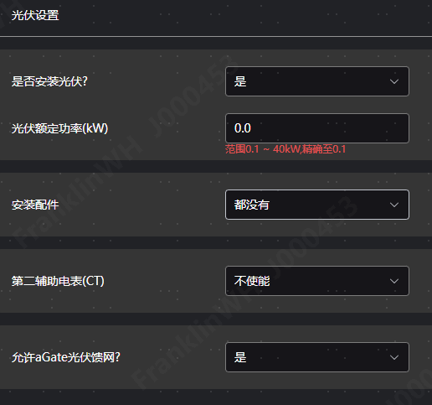
4. Actual operation status of the site
Number of sites for NEM+ & BYOD: 0
Number of sites for NEM+ & BYOD+: 1
10060001A00F23050342 Currently using NEM+ & BYOD, the configuration is as shown on the right:
No NEM PV;
New PV installed;
New PV allows grid feed

Slide 6
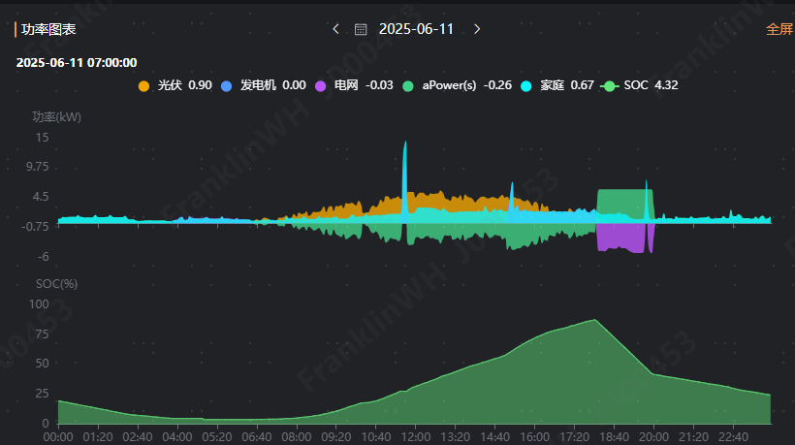
4. Actual operation status of the site
7:00~15:00: Photovoltaic load supply and charging. If the battery SOC is lower than the minimum discharge SOC, aPower will not discharge and will draw power from grid if the energy is insufficient.;
15:00~18:00: PV gives priority to charging aPower, aPower does not participate in load supply；
18:00~20:00: Discharge for two hours according to the contract；

