Slide 1
NEM+ Training Materials
2024-9-5

Slide 2
NEM+ in Hawaii
The Hawaiian Electric Cos. launched Net Energy Metering Plus (NEM+) on October 12, 2018, only available to NEM customers. It allows customers to add battery storage as well as extra panels to their rooftop solar systems without affecting their NEM status — as long as the new equipment doesn’t export power to the grid.
This program benefits NEM customers whose energy demand routinely exceeds the supply provided by their rooftop solar or other renewable distributed energy resource (DER) system. It also benefits NEM customers who are considering renovations or purchases that increase electricity use, such as electric vehicles.
There are no program capacity limits or queues, so there are no deadlines to meet. The only pre-requirement for participation is an active NEM agreement.

Slide 3
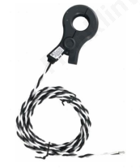
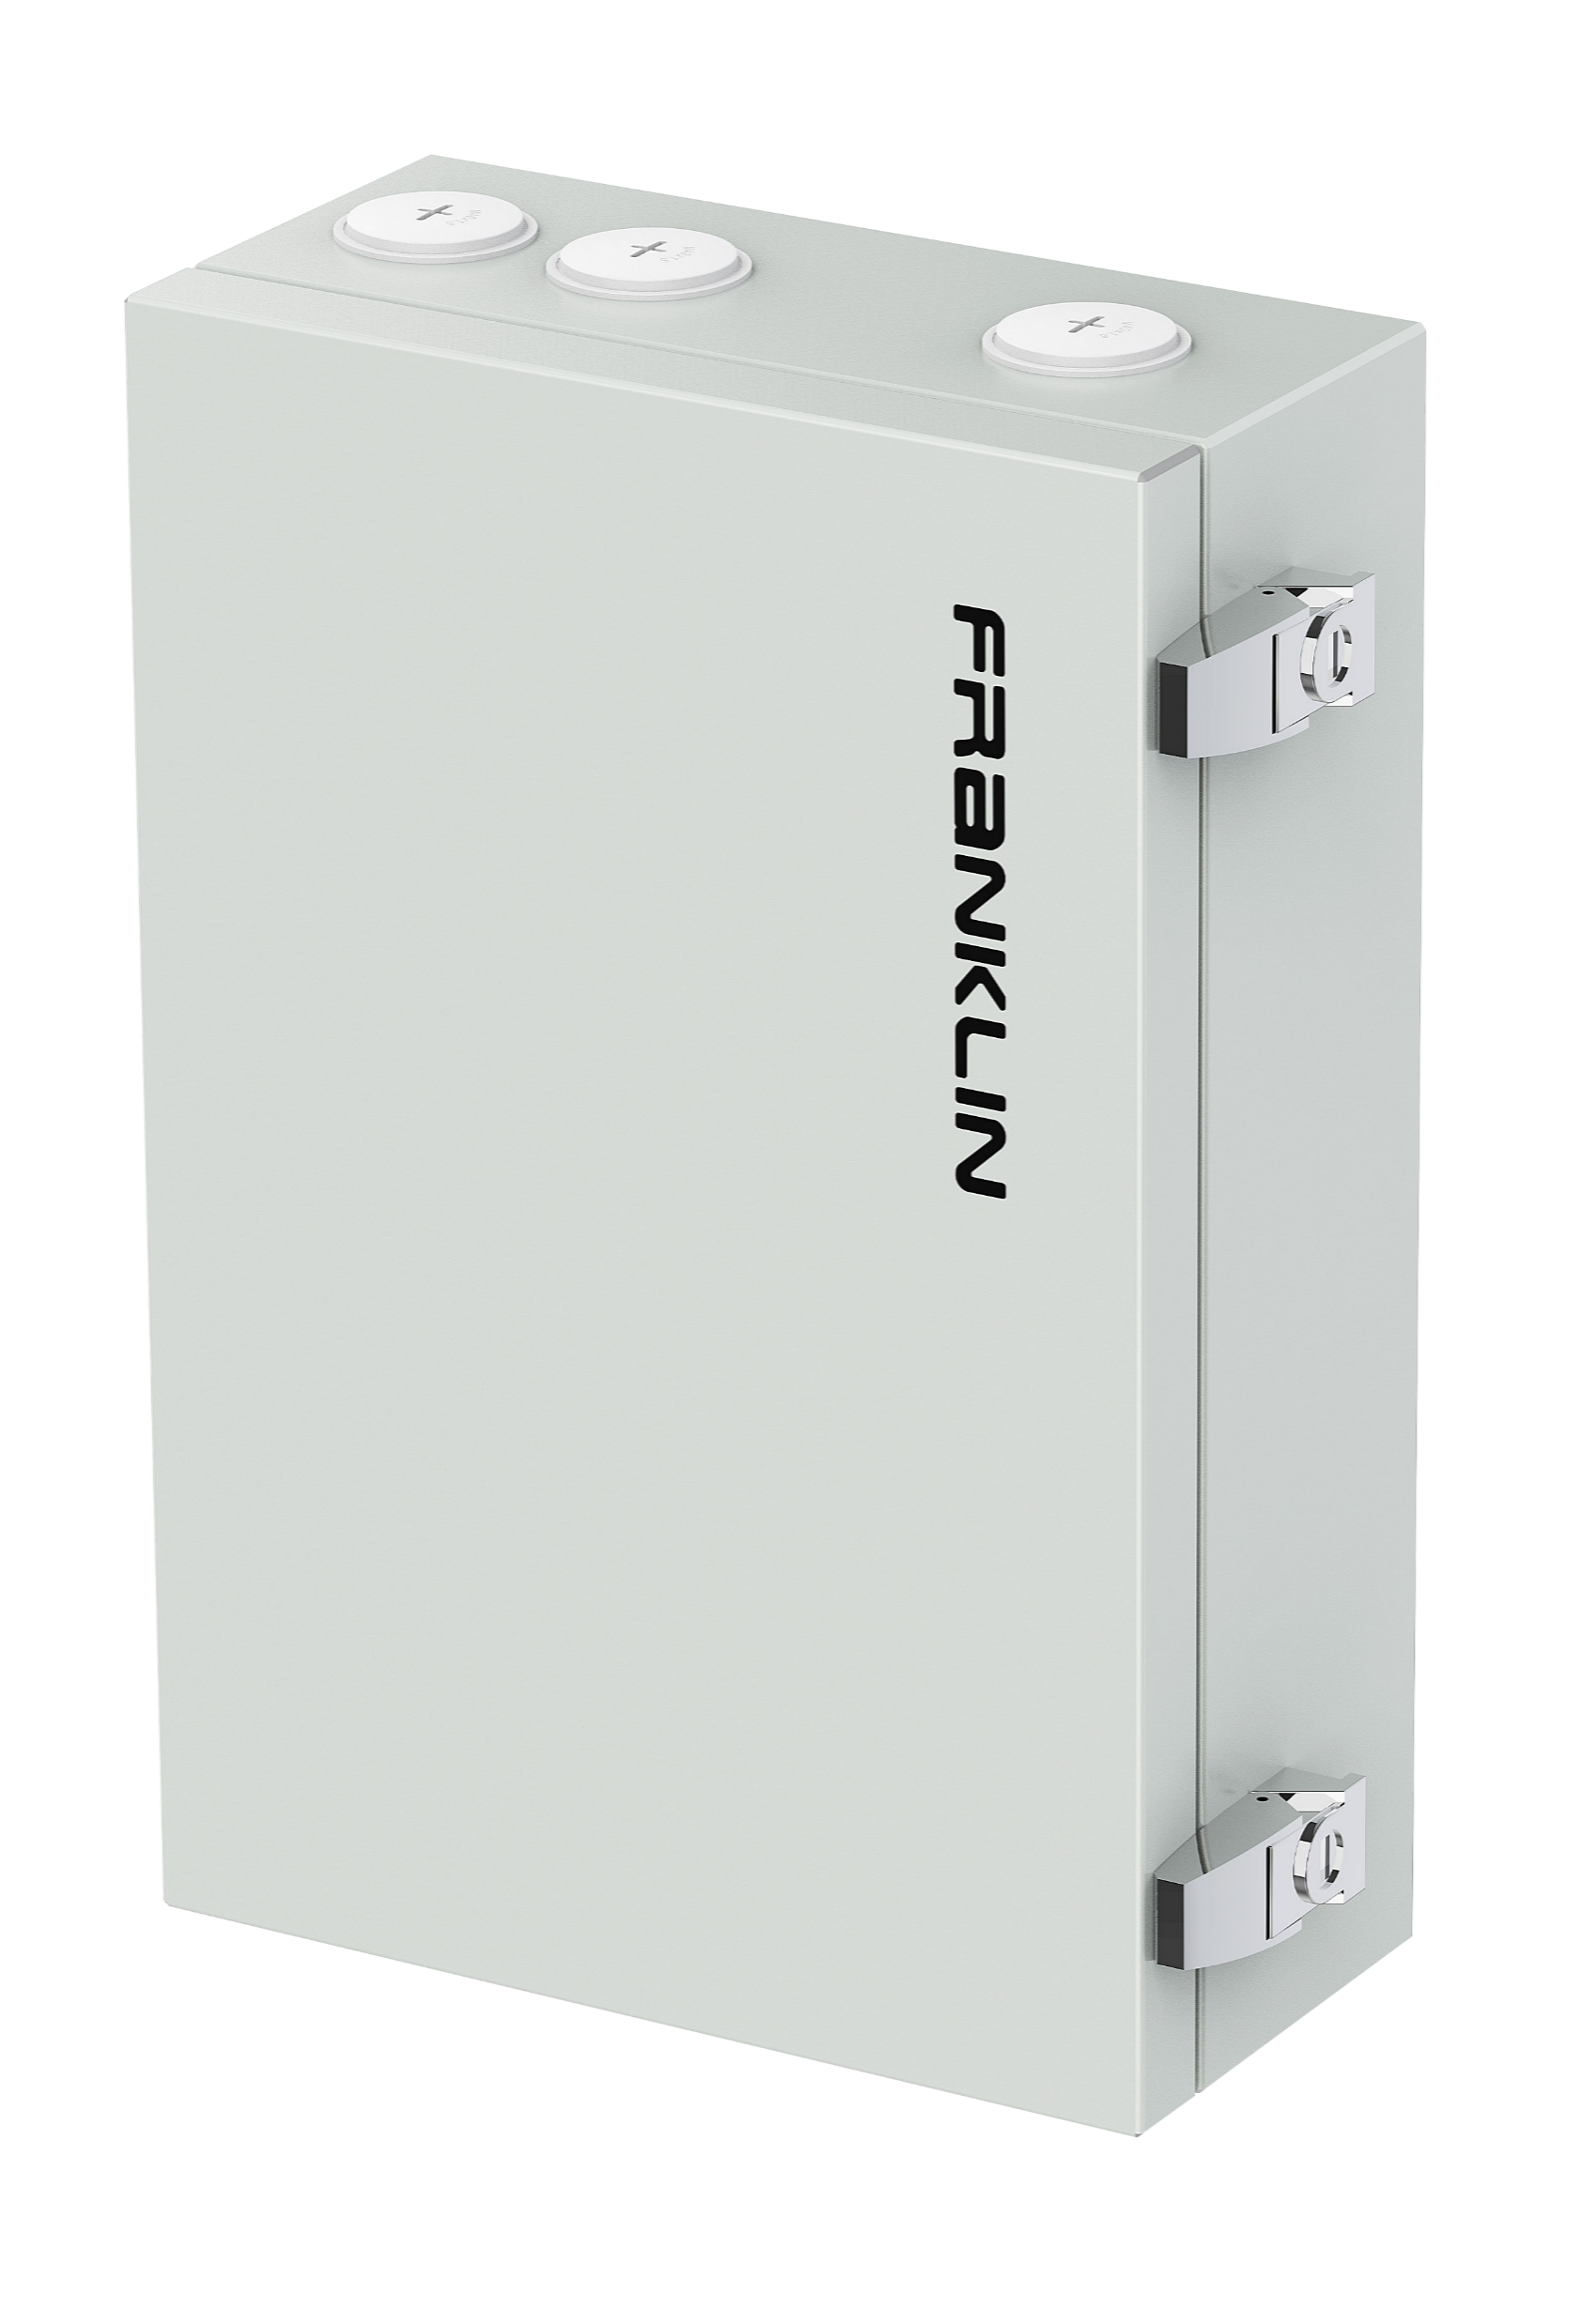
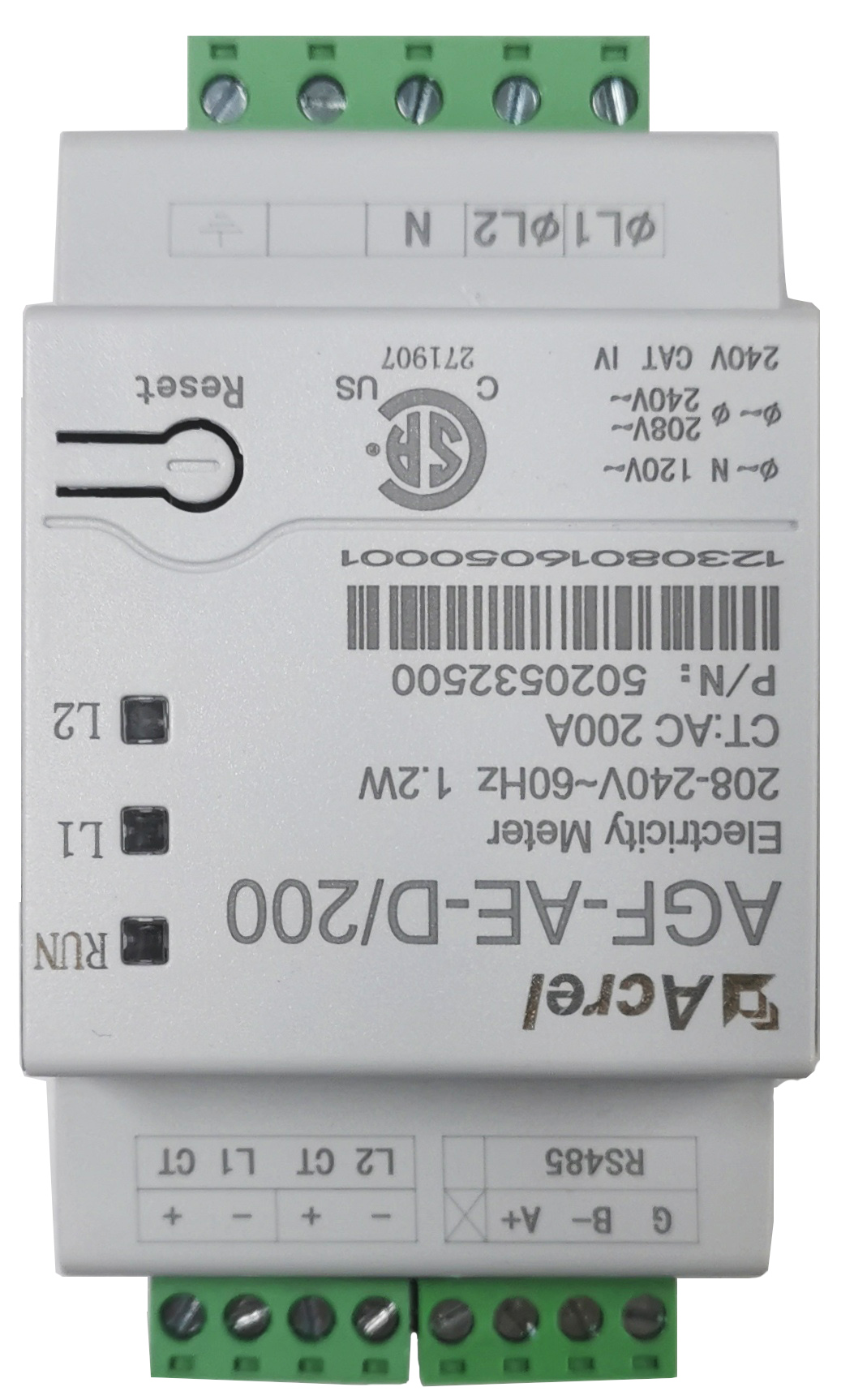
Overview
Option | Option 1 | Option 2 | Option 3
Components | Split CT | Meter Kit | aPbox
Existing NEM PV | Line-side(Page3) Non-backup LoadSide(Page7) | Line-side(Page12) | Line-side Load-side(Page16)
Distance | 0-40m | 40-100m | 40-100m
Features | Cheap | - | Scalability
1.3 aGate EMS introduction(Page10)
1.3 aGate EMS diagram(Page11)

Slide 4
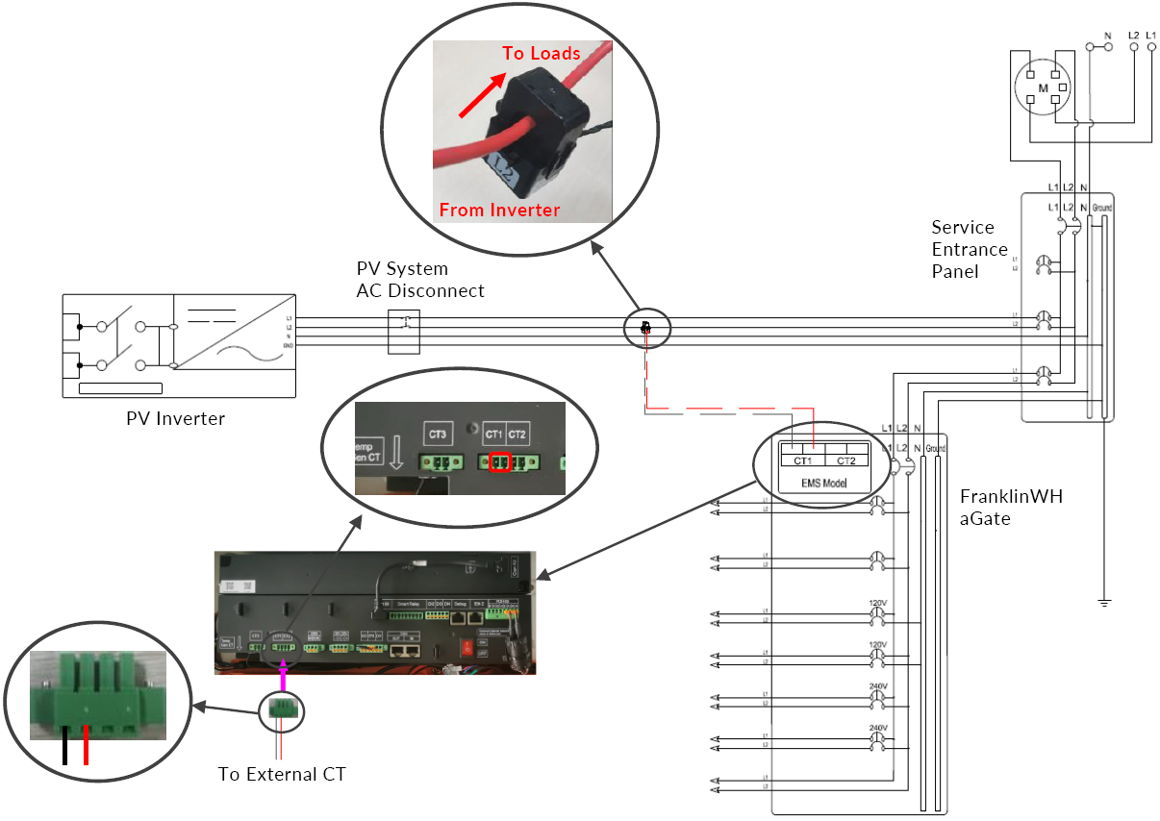
Option 1:External CT on Line Side – Wiring Solution
External CT plugged into the CT1 interface of the EMS
Different CT1 position on aGate1.1 and aGate1.3
Cable length between the existing NEM solar and the aGate is less than 130 ft (40 m)
NOTE:
The factory CT cable has a length of 50 ft (15 m). If it is not sufficient, an extension cable is required. It is recommended to use 20 AWG or larger twisted pair conductors.
The external CT should be installed in a NEMA 3R type enclosure for protection.

Slide 5
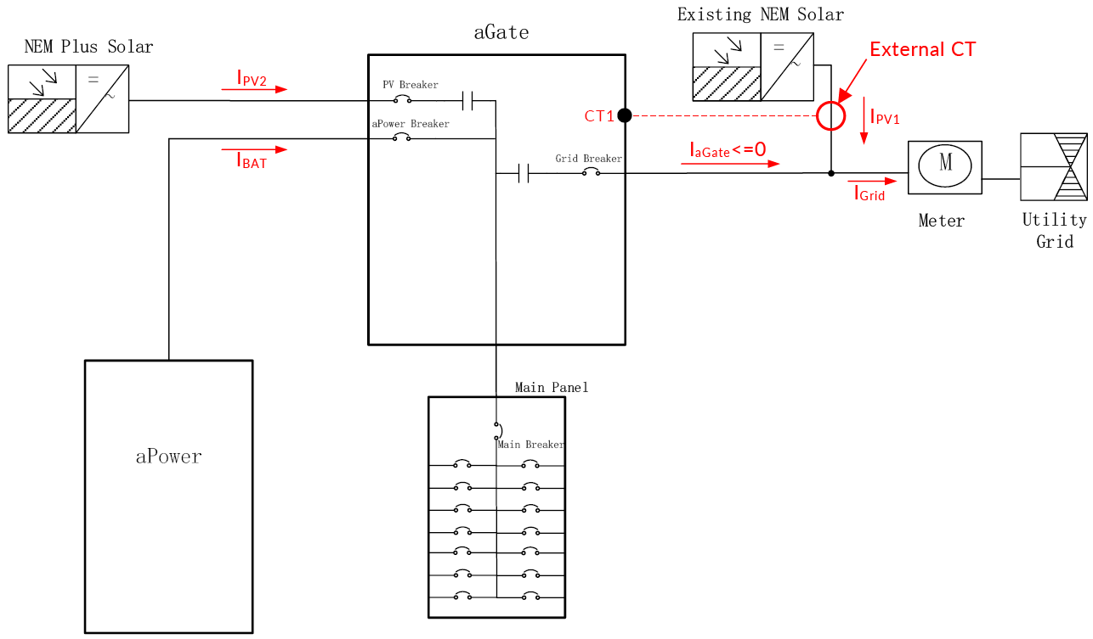
Option 1:External CT on Line Side - Brief
Existing PV
  Adding an external CT to EMS port (CT1).
  No retrofit job on existing PV connection wires.
  The existing PV solar energy can be exported to the grid.
  PV generation will be close when grid outage.
Primary PV (New adding PV)
  Led to the aGate.
  The solar generation is non-export.
  And it can generate the solar energy during the grid outage until PV curtailment when generation is over the load.
PV curtailment
  First by Primary PV to aGate (non-export)
  Existing PV will be close when grid outage.

Slide 6


Option 1:External CT on Line Side - Principle
Principle
Increase external CT for monitoring Existing PV, but without control function.
Use software strategy to make aGate's current to the grid less than or equal to 0, only allowing Existing PV to export to the grid.
$$I_{Grid}=I_{PV1}+I_{aGate}$$
$$I_{aGate}≤0$$

Slide 7
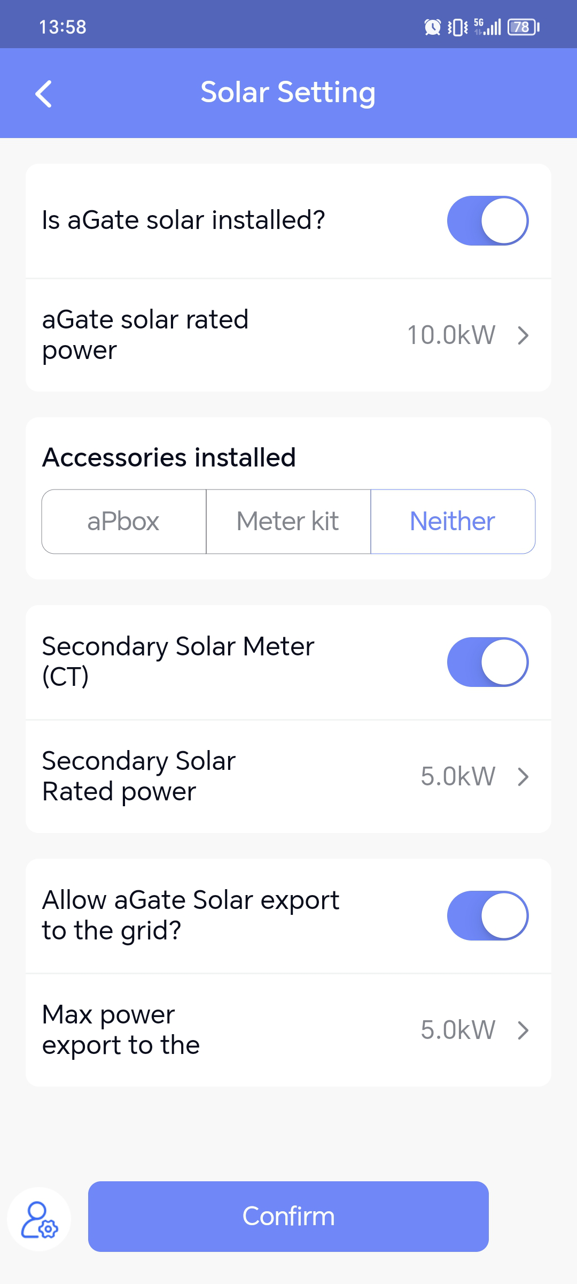
Option 1:External CT on Line Side - App configuration
App (Installer Account)
System Parameters -> Solar Setting:
Secondary Solar Meter (CT) -> Enable
Secondary Solar Rated Power (kW) -> x Kw

Slide 8
aGate 1.3 sulotion:External CT on Non Backup LoadSide(Scenario 1)
1.3 aGate
Grid
EMS
GridSplitCT (CT3/4)
InternalCT NEM CT (CT1)
Main Panel
NEM+ PV
aGatePV
GridSplitCT @L1L2 EMS CT3/CT4
Bat
aPower
Load1 70A
Load2 60A
Internal CT
NEM PV
NEM CT @L2
EMS/CT1
Sub Panel
Load Side
Panel
Non Backup
Load Side
Panel
External CT plugged into the CT1 of EMS
GridSplitCT plugged into CT3/4 of EMS
Unplug Internal CT(Grid_L1/L2)connector of EMS
Note: With GridSplitCT on sub panel.. NEM PV become a non-backup load side PV.(after meter)
P_{grid} read from CT3/CT4
P_{pv} read from (aGatePV + NEM CT)

Slide 9
aGate 1.3 sulotion:External CT on Non Backup LoadSide(Scenario 2)
1.3 aGate
Grid
EMS
GridSplitCT (CT3/4)
InternalCT NEM CT (CT1)
Main Panel
NEM+ PV
aGatePV
GridSplitCT @L1L2 EMS CT3/CT4
Bat
aPower
Load1 70A
Load2 60A
Internal CT
NEM PV
NEM CT @L2
EMS/CT1
Sub Panel
External CT plugged into the CT1 of EMS
GridSplitCT plugged into CT3/4 of EMS
Load Side
Panel
Non Backup
Load Side
Panel
P_{grid} read from (CT3/CT4 + InternalCT)
P_{pv} read from (aGatePV + NEM CT)

Slide 10
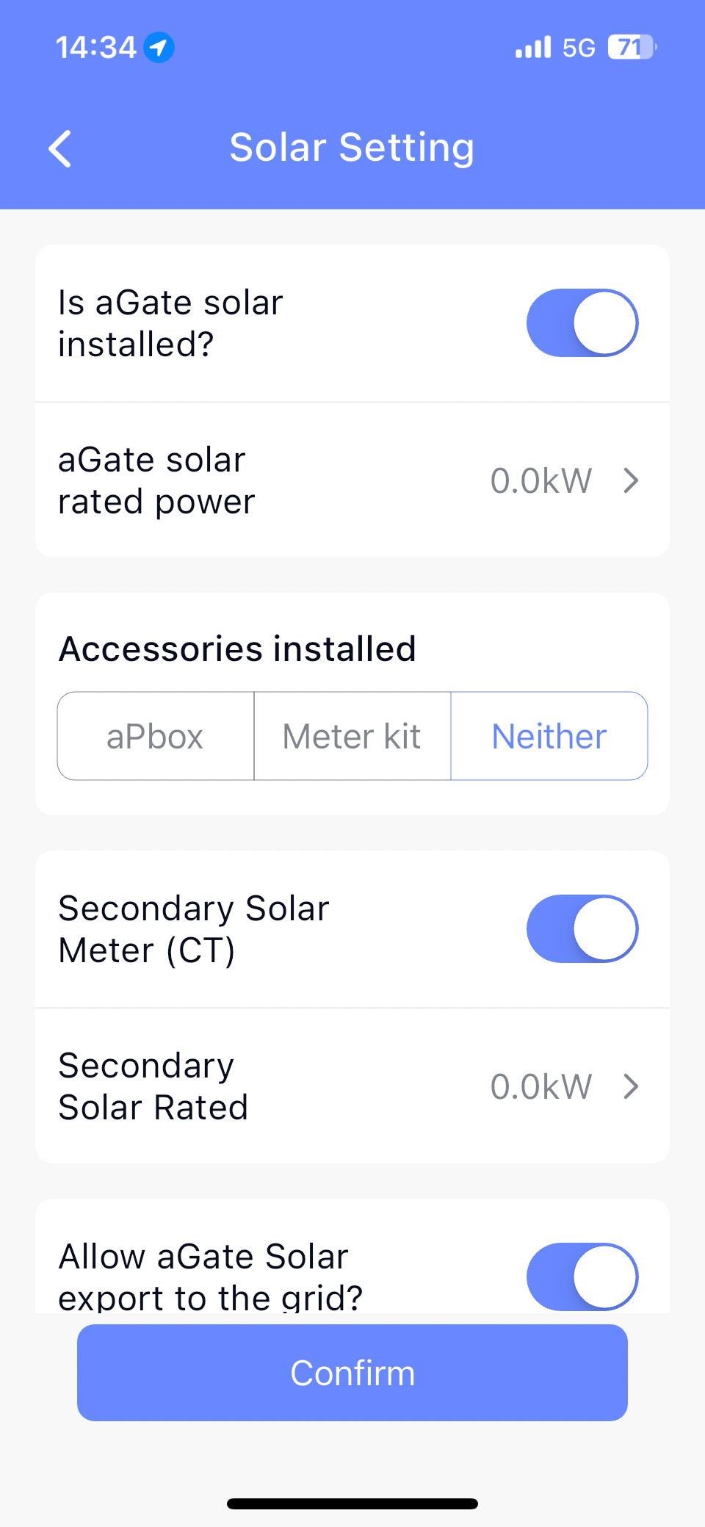
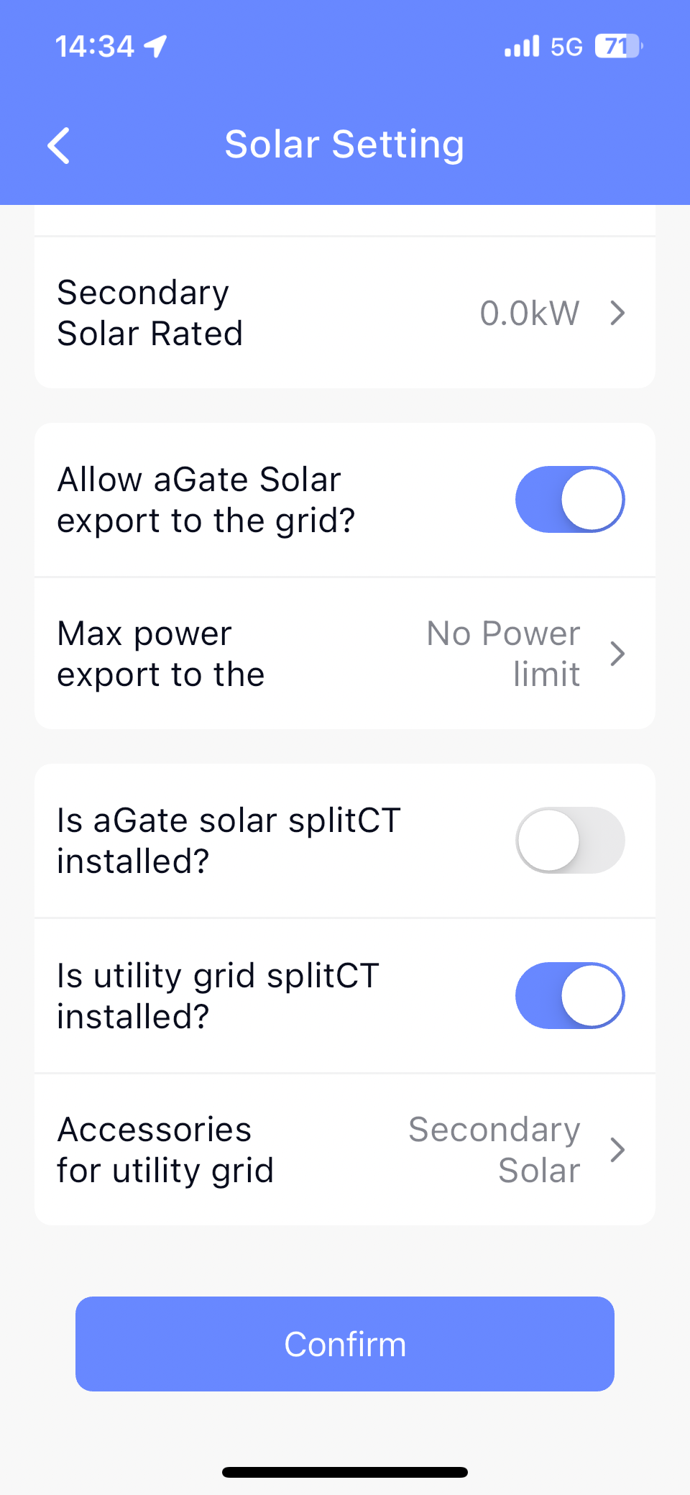
aGate 1.3 sulotion:External CT on Non Backup LoadSide
App (Installer Account)
System Parameters -> Solar Setting:
Secondary Solar Meter (CT) -> Enable
Secondary Solar Rated Power (kW) -> x.x Kw
Is utility grid splitCT installed? -> Enable
Accessories for utility grid -> Secondary Solar Meter

Slide 11
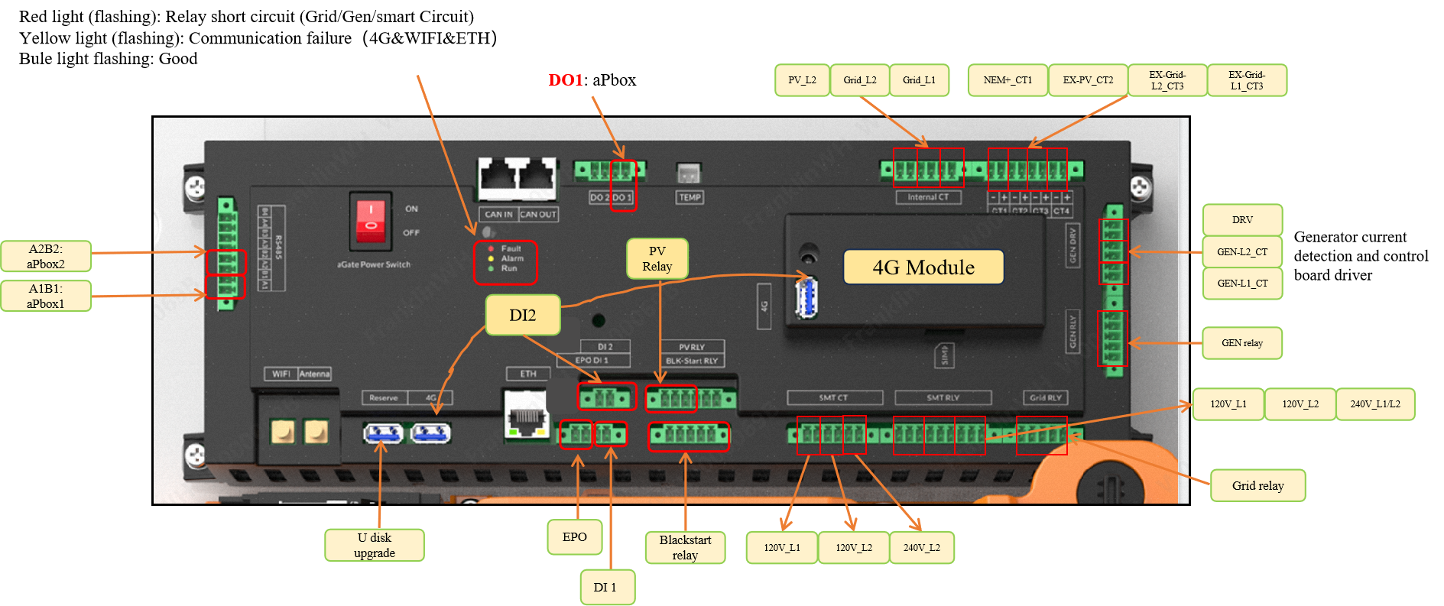
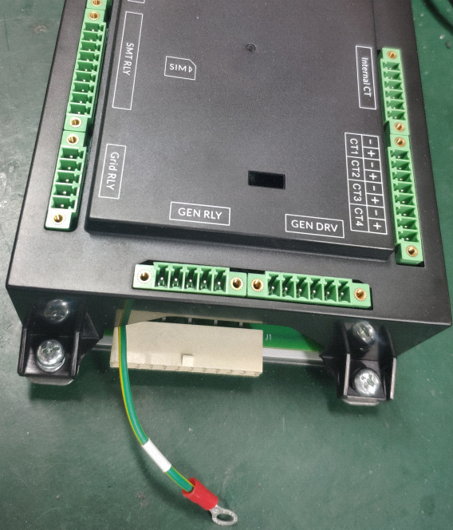
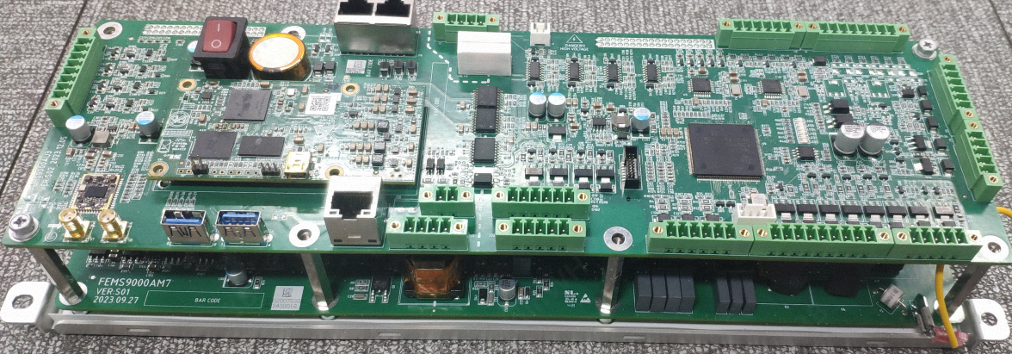
Box introduction - 1.3 aGate EMS
What are the differences?
Reduce the size of EMS by changing the PCBA layout
Add indicator lights
Add u disk port
Change control port of aPbox
Delete the 20V auxiliary power ports
All terminals are supplied with screws
Add a reserved DO2
Add CT ports
Why do we make the changes?
Reduce the cost
Help installers to diagnose normal faults
Support no-network upgrade
20V auxiliary power ports are useless
Avoid communication faults caused by loose teminals
U3:Control Board
(1) Distance between aGate and No.1 aPower < 30m, no need extra operation
(1) Distance between aGate and No.1 aPower ≥ 30m, need repeater and R&D assistance
M7: Power Source Board
Voltage Sampling Terminal

Slide 12
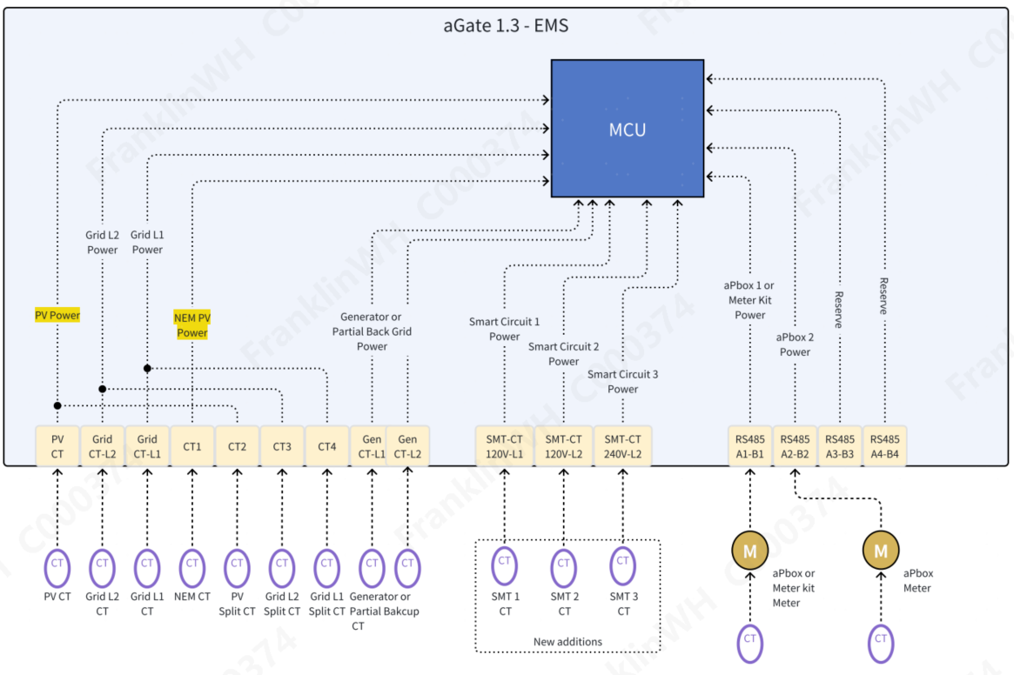
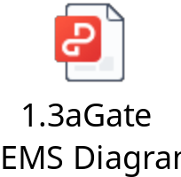
Notes:
1.PV SplitCT (CT2)short to PV CT in EMS,work as one PV meter.
2.GridL1/L2 Split CTs (CT3/CT4) short to GridL1/L2 CT in EMS, work for aGate meter.
3.NEM CT/ Gen CT/ SMT CTs service as a full meter.

Slide 13
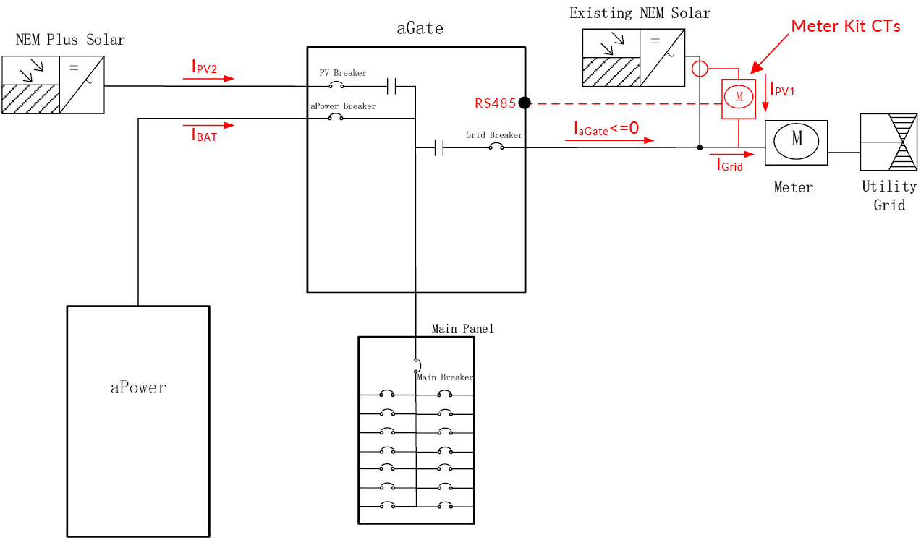
Option 2: Meter Kit CTs
Brief:
Existing PV
  Adding a remoter meter.
  No retrofit job on existing PV connection wires.
  The existing PV solar energy can be exported to the grid.
  PV generation will be close when grid outage.
Primary PV (New adding PV)
  Led to the aGate.
  The solar generation is non-export.
  And it can generate the solar energy during the grid outage until PV curtailment when generation is over the load.
PV curtailment
  First by Primary PV to aGate (non-export)
  Existing PV will be close when grid outage.

Slide 14
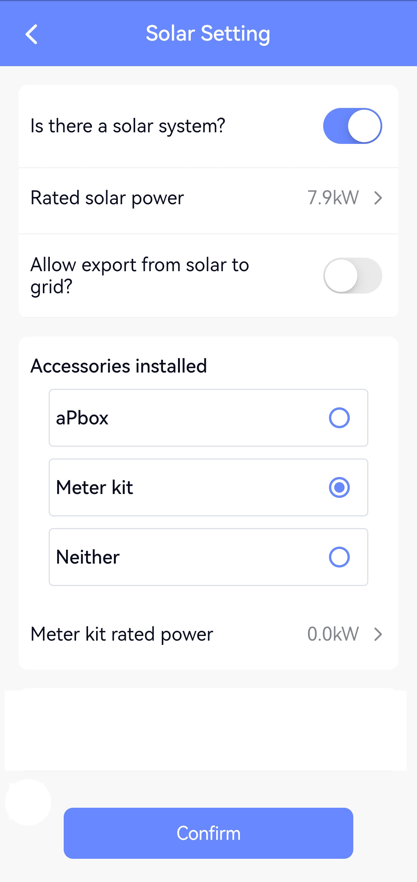
Option 2: Meter Kit CTs – App Setting
Enter the existing NEM solar rated power
Select Meter kit and set Meter kit rated power as the existing NEM solar rated output during commissioning Solar Setting tab.

Slide 15
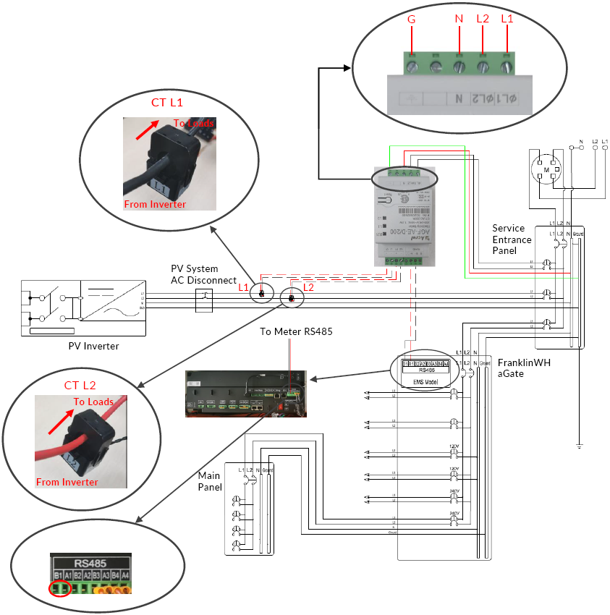
Option 2: Meter Kit CTs – Wiring Solution
All electrical installations shall comply with all national and local electrical codes. Recommended Wire size and service entrance panel OCPD rating as shown in the table below.
Type | Specifications
AC Wire | 12-14 AWG stranded wire, 600 V, type THHN, MTW, or THWN
RS485 Wire | 16-20 AWG
OCPD Rating | 15 A
The length of the communications cables between the Meter kit and the aGate shall not exceed 328 feet (100 meters).
放在盒子里
SKU 怎么下单 多少钱，已有物料编码，带包材

Slide 16
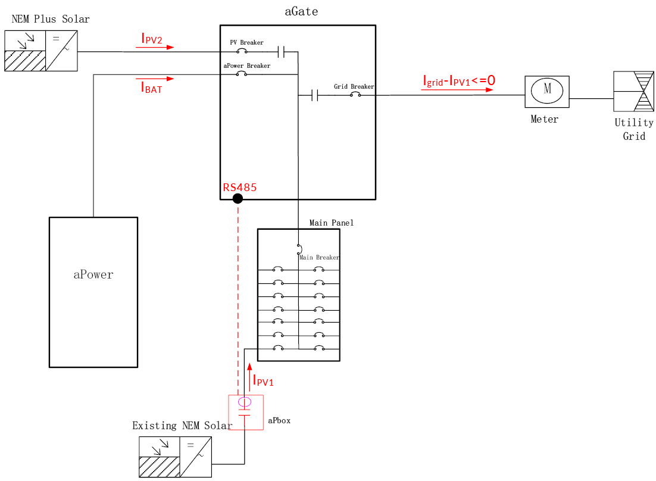
Option 3: aPbox in load side
待定
Brief:
Existing PV to a backup panel
  Adding an aPbox in load side.
  Retrofit job: Move the existing PV connection wires from backup panel to the aPbox, then lead to backup panel breaker again.
  The existing PV solar energy can be exported to the grid.
  PV curtailment when grid outage.
Primary PV (New adding PV)
  Led to the aGate.
  The solar generation is non-export.
  And it can generate the solar energy during the grid outage until PV curtailment when generation is over the load.
PV curtailment
  First by Primary PV to aGate (non-export)
  Next by aPbox to backup panel when grid outage.

Slide 17
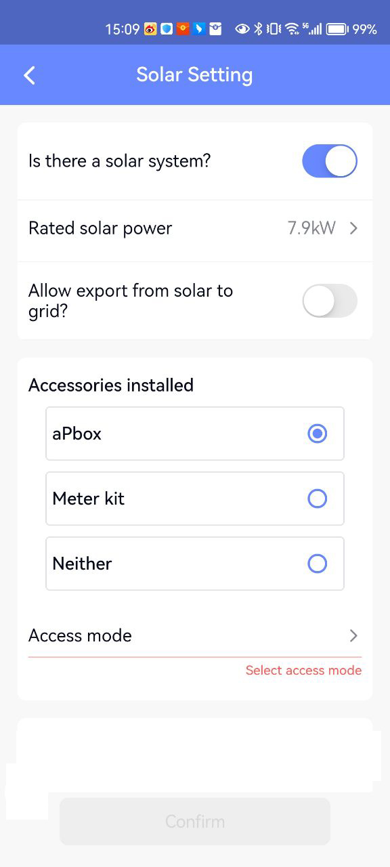
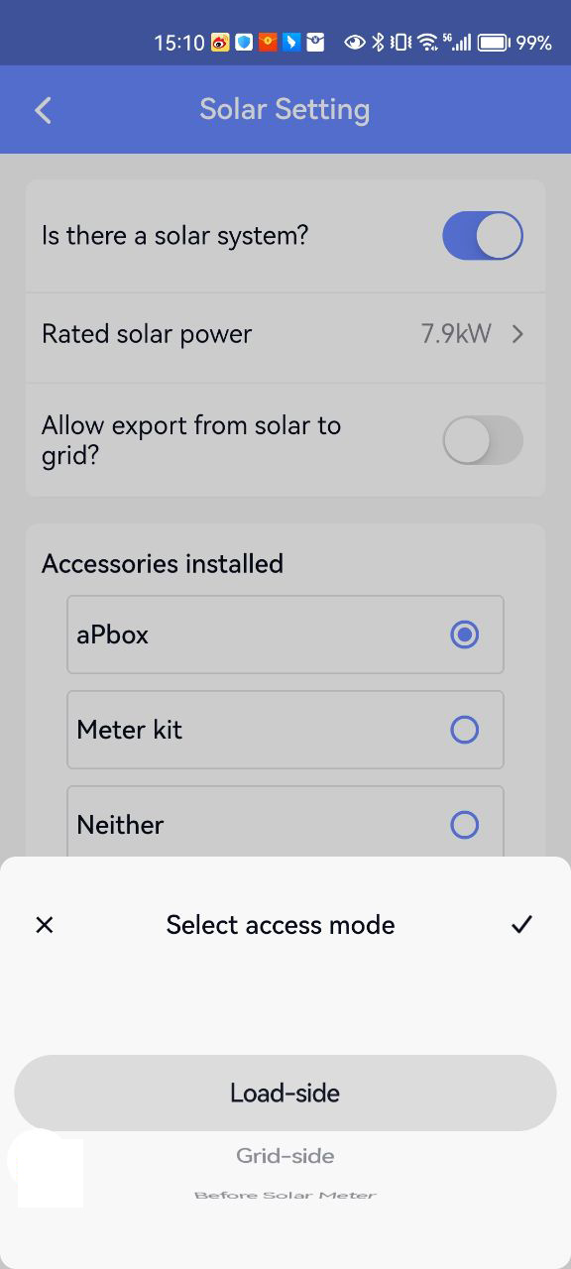
Option 3: aPbox in load side – App Setting
软件策略要确定一下
Select aPbox and set Access mode where the aPbox is placed during commissioning under Solar Setting tab.

Slide 18

Option 3: aPbox in load side – Principle
Principle:
Install Existing PV on the load side and use aPbox to monitor and control them.
Use software strategy to make the current to the grid less than or equal to the current of the Existing PV, so that for the grid, only the Existing PV are feeding into it.
$$I_{Grid}=I_{aGate}≤I_{PV1}$$

Slide 19
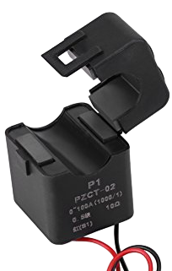
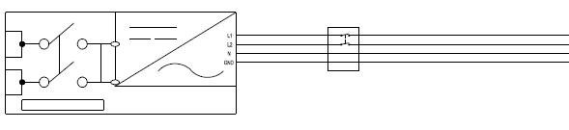
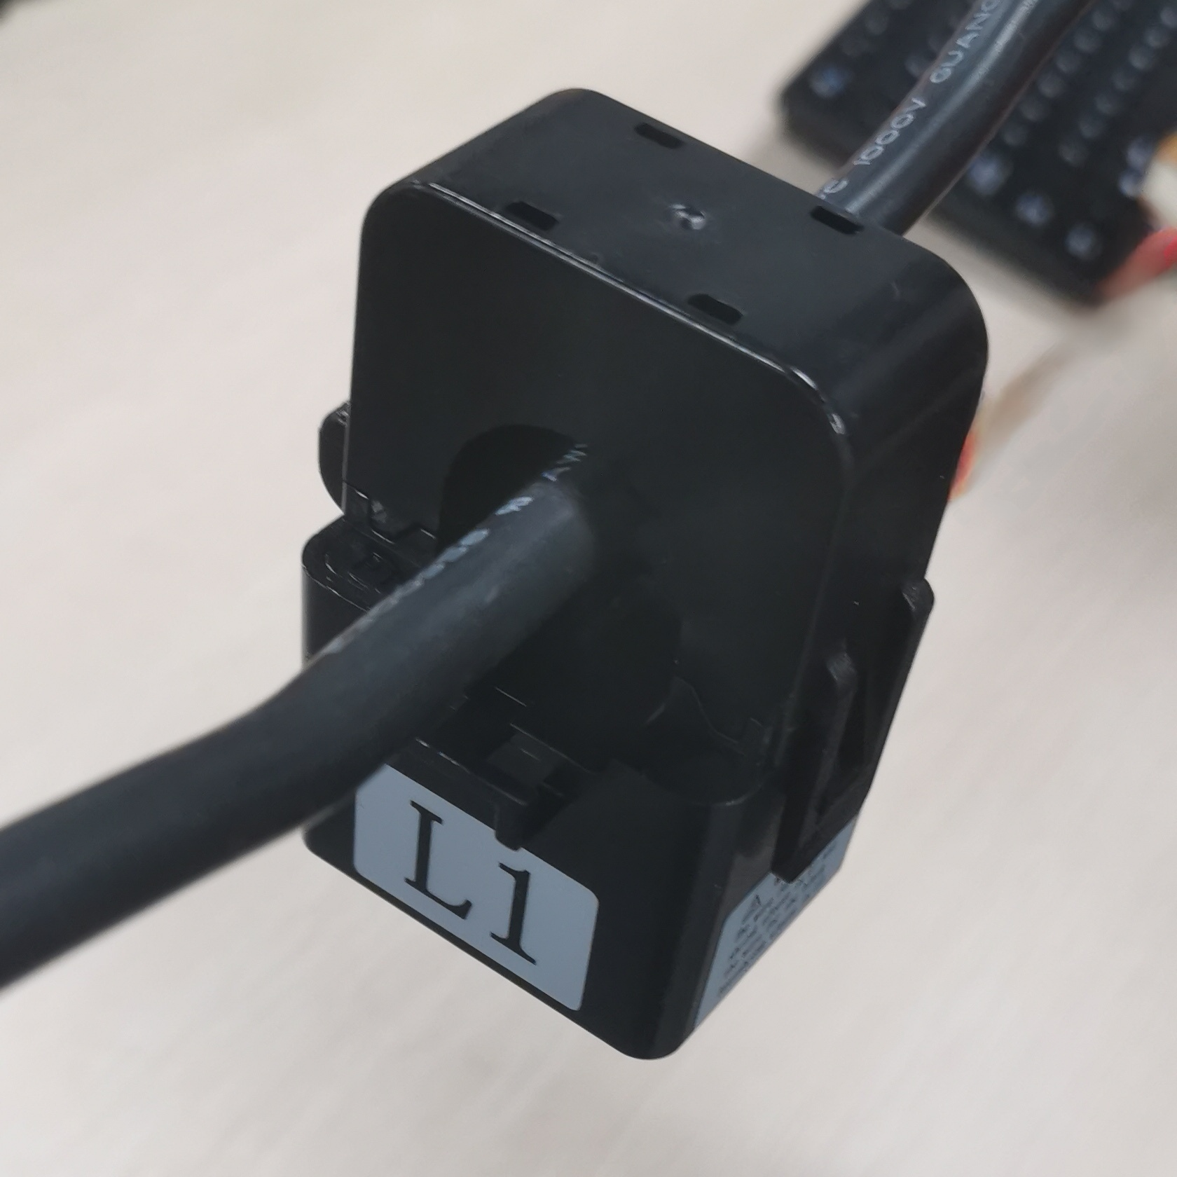
Possible problems and solutions
A+
A-
Inappropriate CT
There are other energy flows in the PV line. CT只卡光伏
The wiring was reversed during installation.
Using the recommended CT
Verify that there are no other energy flows in the PV line
Ensure that the wiring matches the silk screen

